Slide 1
Robotics Project Study of local path planning in a dining hall service robot scenario
Team 1
Jee Yong Park
Seungyoon Lee
Junhyeok Lim

Slide 2
Summary
Aim: study & implement online dynamic path planning algorithms
Scenario: mobile robot for dining hall service (food delivery)
Simulated environment and configuration – reasonably rescaled

Slide 3
Scenario
Dining hall walkway, approx. 2m x 4m+, tables on either long edges
Customer orders via GUI
When ready to serve, waiter inputs table number via GUI and puts food on robot
Robot detects payload and knows when to start navigation
Robot navigates to designated table, avoiding unmapped static obstacles (chairs, bags, etc.) and dynamic obstacles (humans)
Robot detects if payload is off and knows when to return home
Similar procedure for returning trays
Experiment in scaled, simulated environment as a demonstration of the concept

Slide 4

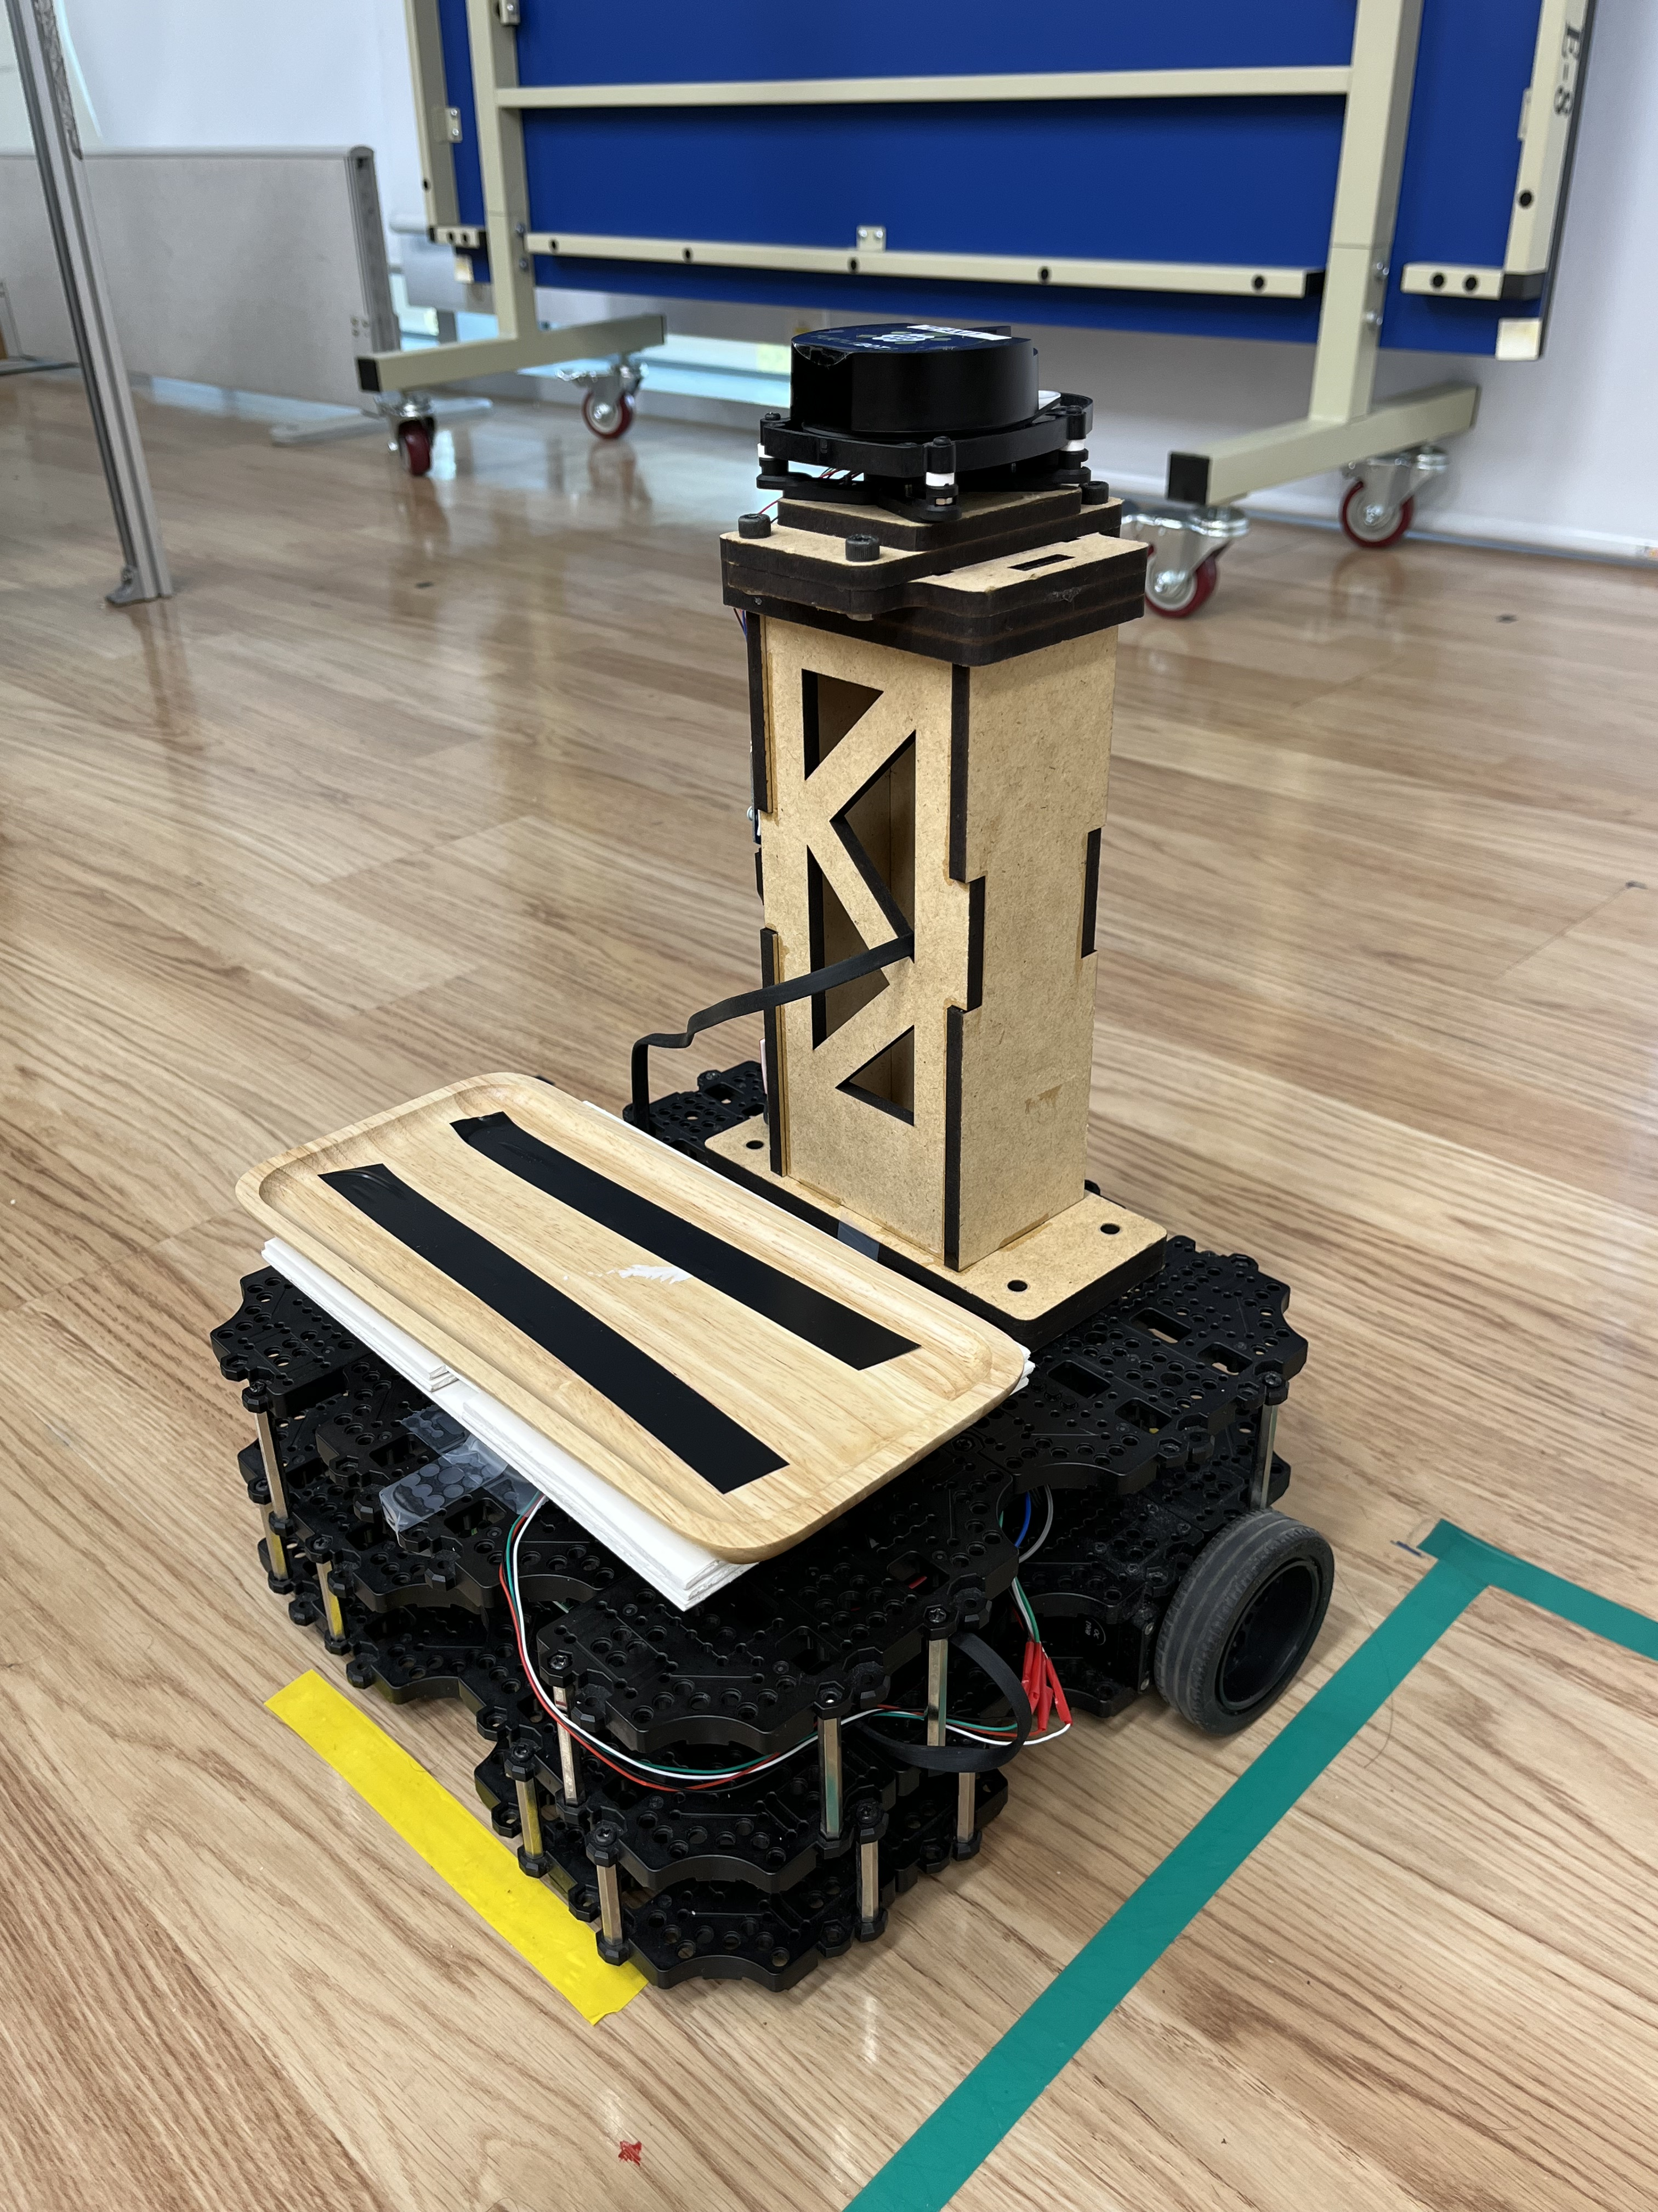




카운터(wall)
복도
Home
테이블 1
테이블 2
테이블 3
Wall

Slide 5
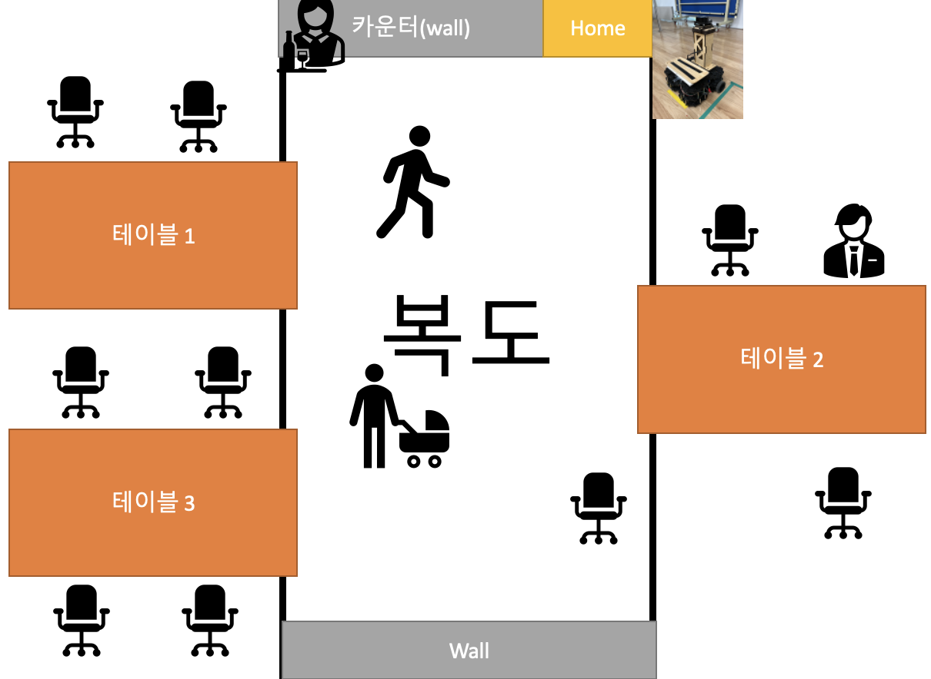
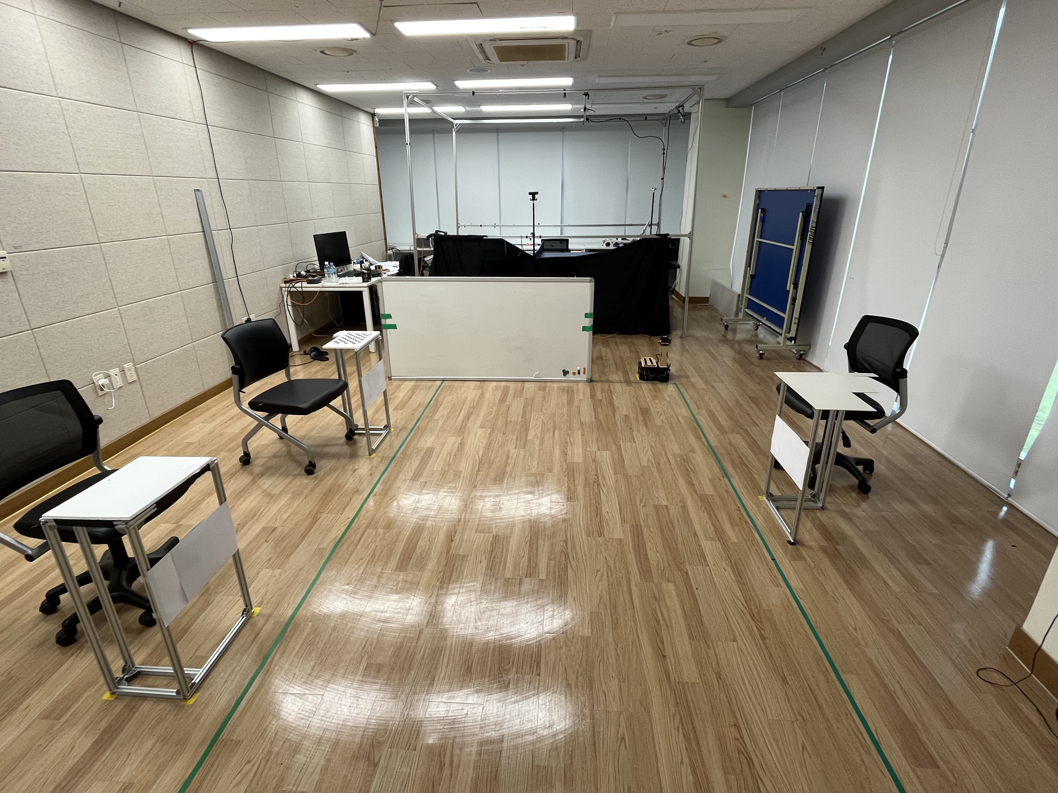
카운터
터틀봇
테이블1
테이블2
테이블3
정면 조감도

Slide 6
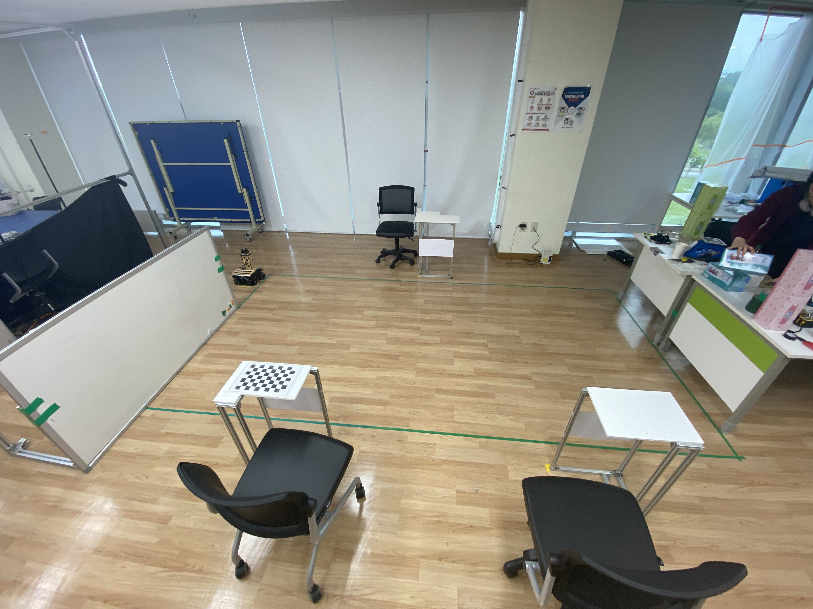
터틀봇
테이블2
카운터
wall
테이블1
테이블3
측면 조감도

Slide 7
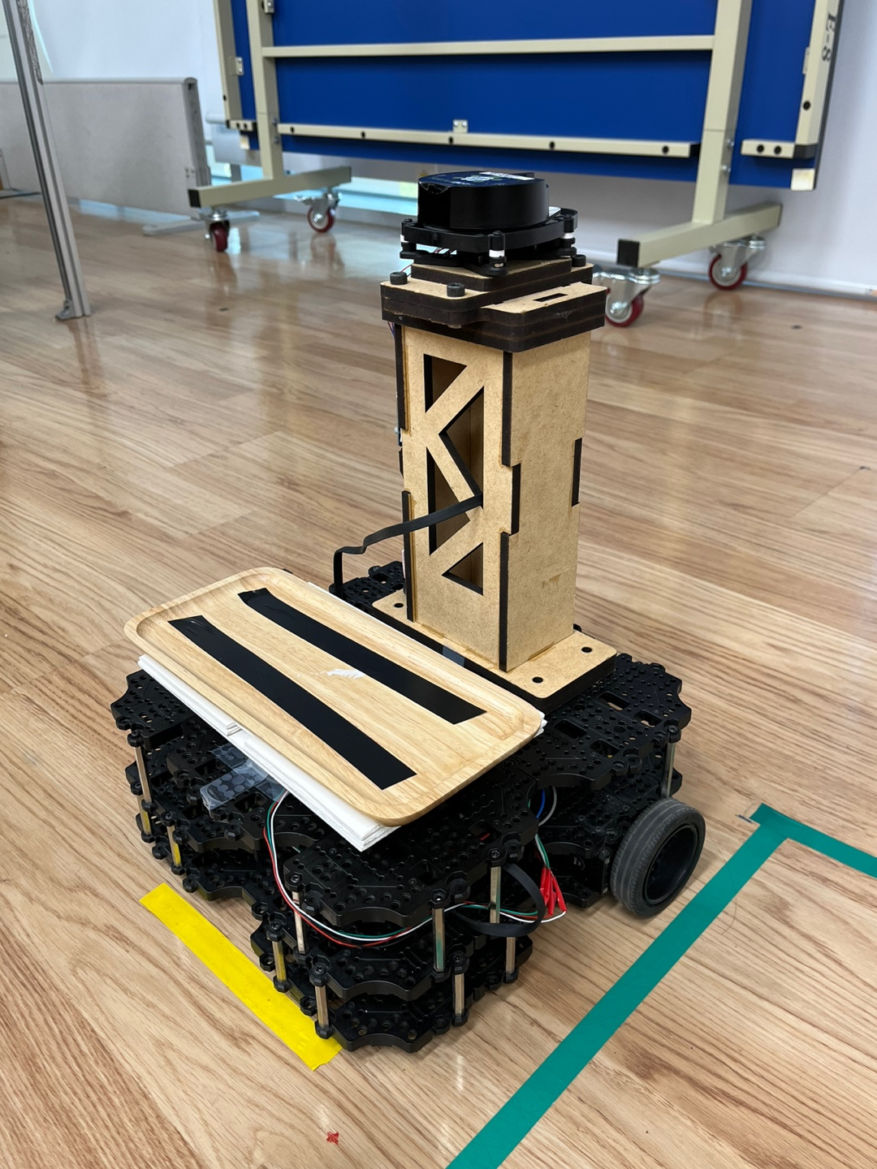
Configuration
Turtlebot3 Waffle Pi
Custom (printed or laser-cut) spring-suspended platform for payload placement & weight detection
2D LiDAR, IMU, RGB camera, load cell weight sensor
ROS Kinetic
Mostly dependent on Turtlebot3 packages

Slide 8
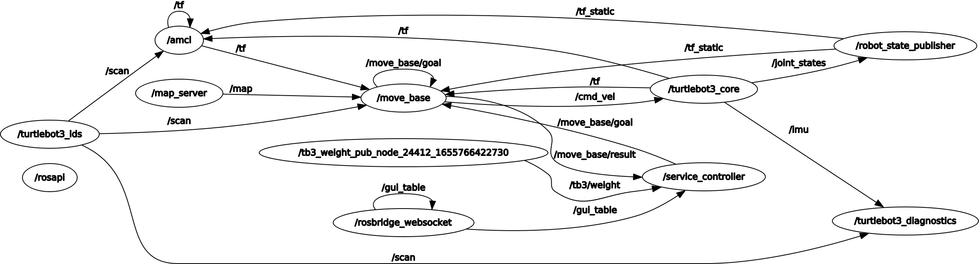
Framework

Slide 9
Tasks proposed
Human interaction
Automatic payload detection
GUI for customer & waiter
Localisation & pose estimation
Default method by 2D LiDAR + odometry fusion
Obstacle detection
Default method for local costmap as baseline
Dynamic local path planning
Main challenge: implement our own dynamic, online local path planner, compare behaviours

Slide 10
Challenges
Custom local path planner
Original plans: fuzzy logic & artificial potential field
Scrapped due to difficulties with C++, ROS plugin, velocity control, etc.
Experimentation with other local planners
TEB (time elastic band): harsh oscillation near obstacles
Inaccurate model parameters of the robot
Inadequate local costmap generation
Heavy computation for ~8-year-old laptop
MPC (model predictive control): unable to install package
Struggles with 3D printer

Slide 11
Observations and evaluation
Satisfactory performance only achieved with DWA (baseline) local planner
Robot deals with dynamic obstacles at reasonable speed & distance with relative ease
Suboptimality, jitter and jerk found when running into unexpected obstacles
LiDAR + IMU fusion AMCL works with negligible error (max 10 cm)
Excessive load (1kg+) causes wheels to slip
2D LiDAR limits the use beyond idealised environment
Robot sometimes seems to “get lost” in finding target orientation

Slide 12
Lessons and takeaways
Understanding of ROS
Navigation stack and move_base
Topics and action clients
ROS file system
Package creation and registration
ROS plugins
Use of rosbridge for interface with web-based applications
Simple solutions are often very effective compared to sophisticated, complex solutions

